Slide 1



A Distributed Timing Analysis Framework for Large Designs
Tsung-Wei Huang and Martin D. F. Wong (ECE Dept., UIUC, IL)
Debjit Sinha, Kerim Kalafala, and Natesan Vankateswaran (IBM, NY)

Slide 2
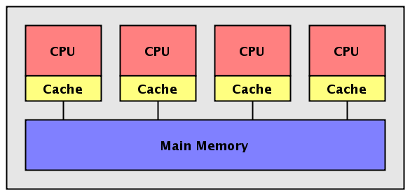
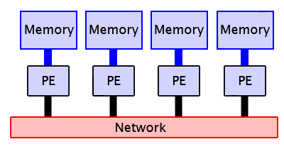
Distributed Timing – Motivation and Goal
Motivation
Ever increasing design complexity
Hierarchical partition
Abstraction
Multi-threading timing analysis
Too costly to afford high-end machines
Create a distributed timing engine
Explore a feasible framework
Prototype a distributed timer
Scalability
Performance
Multi-threading in a single machine
Distributed computing on a machine cluster

Slide 3
State-of-the-art Distributed System Packages
Open-source cloud computing platforms (https://hadoop.apache.org/)
Hadoop
Reliable, scalable, distributed MapReduce platform on HDFS
Cassandra
A scalable multi-master database with no single points of failure
Chukwa
A data collection system for managing large distributed systems
Hbase
A scalable, distributed database that supports structured data storage
Zookeeper
Coordination service for distributed application
Mesos
A high-performance cluster manager with scalable fault tolerance
Spark
A fast and general computing engine for iterative MapReduce

Slide 4
The Questions Are
Are these packages really suitable for our applications?
Google/Hadoop MapReduce programming paradigm
Spark in-memory iterative batch processing
What are the potential hurdles for EDA to use big-data tools?
Big-data tools are majorly written in JVM languages
EDA applications highly rely on high-performance C/C++
Rewrites of numbers of codes
What are the differences between EDA and big data?
Computation intensive vs Data intensive
EDA data is more connected than many of social network

Slide 5
An Empirical Experiment on Arrival Time Propagation
Bebchmark
Timing graph from ICCAD 2016 CAD contest (superblue18)
2.5M nodes
3.5M edges
Implementation
Spark – 4 cores
Java, Scala, etc. – 1 core
C++ – 1 core
Implementation | Spark 1.4 (RDD + GraphX Pregel) | Scala (Dijkstra) | C++ (Dijkstra)
Runtime (s) | 68.45 | 10.68 | 1.50
Overhead of GraphX and message passing
Overhead of JVM

Slide 6
The Proposed Framework for Distributed Timing
Focus on general design partitions
Logical, physical, and hierarchies
Across multiple machines (DFS)
Single-server multiple-client model
Server is the centralized communicator
Client exchange boundary timing with server
Client on Machine “C”
(Send/Recv message to/from server
on machine “P”)
Client machine IP: 1.23.456.789
Server on Machine “P”
(Send/Recv message to/from client
on machine “C”)
An example design with three partitions
Server machine IP: 140.110.44.32

Slide 7
Key Components in our Framework
Multiple-program multiple-data paradigm
Different programs for clients and server
Better scalability and work distribution
Non-blocking socket IO
Program returns to users immediately
Overlap communication and computation
Event-driven environment
Callback for message read/write events
Persistent in memory for efficient data processing
Efficient messaging interface
Network see bytes only
Serialization and deserialization of timing data

Slide 8

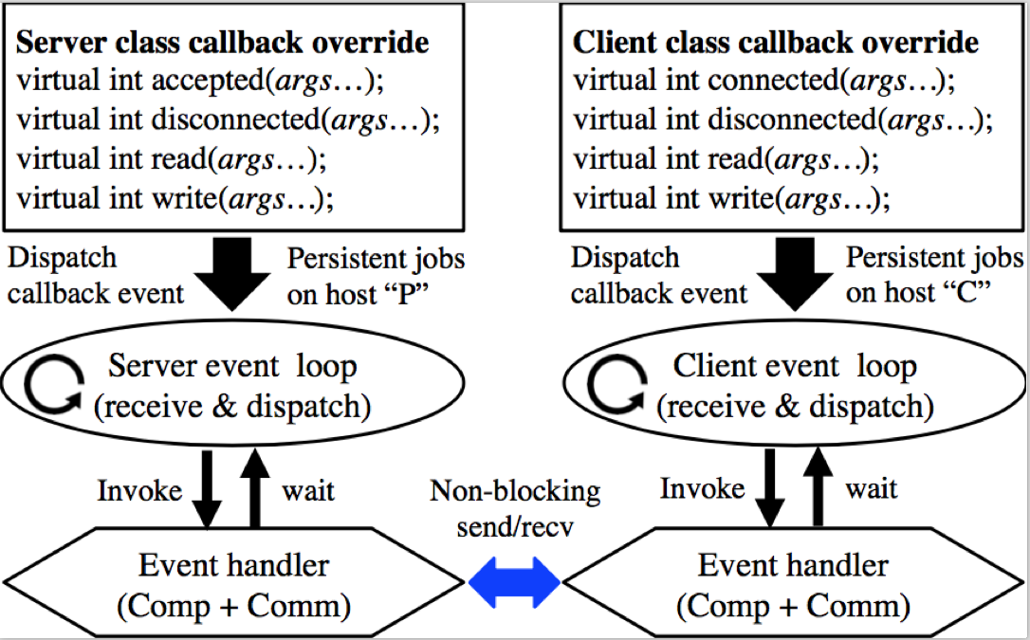
Non-blocking IO and Event-driven Loop with Libevent
Libevent (http://libevent.org/)
Open-source under BSD license
Actively maintained
C-based library
Non-blocking socket
Reactor model
// Magic inside dispatch call
while (!event_base_empty(base)) {
// non-block IO by OS kernel
active_list ← get_active_events
foreach(event e in active_list) {
invoke the callback for event e
}
}
Interface class in our framework (override virtual methods for event callback)
An example event-driven code

Slide 9
Callback Implementation
Client read callback
Receive boundary timing
Propagate timing
Send back to the server
Server read callback
Keep boundary mapping
Receive boundary timing
Propagate timing
Send to the client
Timing propagation
Frontier vs Speculative
Frontier timing propagation follows the topological order of the timing graph
If multi-threading is available, spare thread performs speculative propagation in order gain advanced saving of frontier work

Slide 10
Efficient Messaging Interface based on Protocol Buffer
Message passing
Expensive
TCP byte stream
Unstructured
Data conversion
Serialization
Deserialization
Protocol buffer
Customized protocol
Simple and efficient
Built-in compression
Integration of Google’s open-source protocol buffer into our messaging interface greatly facilitates the data conversion between application-level developments and socket-level TCP byte streams.

Slide 11
Evaluation – Software and Hardware Configuration
Written in C++ language on a 64-bit Linux machine
3rd-party library
Libevent for event-driven network programming
Google’s protocol buffer for efficient messaging
Benchmarks
250 design partitions generated by IBM EinsTimer
Millions-scale graphs generated by TAU and ICCAD contests
Evaluation environment
UIUC campus cluster (https://campuscluster.illinois.edu/)
Each machine node has 16 Intel 2.6GHz cores and 64GB memory
384-port Mellanox MSX6518-NR FDR InfiniBand (gigabit Ethernet)
Up to 250 machine nodes

Slide 12
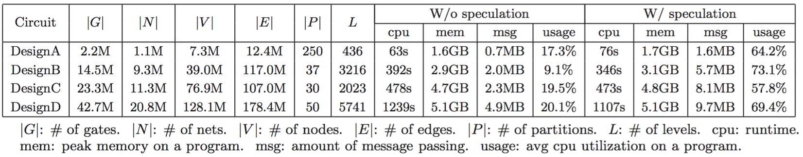
Evaluation – Results and Performance
Overall performance
Scalability
Scale to 250 machines (DesignA)
Runtime efficiency
Less than 1 hour on large designs (DesignC and DesignD)
Memory usage
Peak usage is only about 5GB on a machine (DesignD)

Slide 13
Evaluation – A Deeper Look
CPU utilization
W/o speculation
W speculation
Runtime profile
7% event polling
3% streaming
23% initialization
54% propagation
12% communication
W/ speculation on DesignD
+49% cpu rate
+4.8MB on message passing
Average cpu utilization over time across all machines.
Runtime profile of our framework (12% on communication and 88% on computation)

Slide 14
Conclusion and Future Work
Prototype a distributed timing analysis framework
Server-client model
Non-blocking socket IO (overlap communication and computation)
Event-driven loop (autonomous programming)
Efficient messaging interface (serialization and deserialization)
Future work
A system for distributed timing analysis
Fault tolerance
Distributed common path pessimism removal (CPPR)
Acknowledgment
UIUC CAD group
EinsTimer team (Debjit, Kerim, Natesan, Hemlata, Adil, Jin, Michel, etc.)

